Slide 1

THE RIDFT :analysis
Presented By:
Daniel Escobedo Chelsea Armbrister
Divyesh Bhakta
Brian LaTulip
Luis Sura Joseph Gwaltney
Advisors: Dr. Okenwa Okoli
Dr. Peter N. Kalu
tarik Dickens

Slide 2
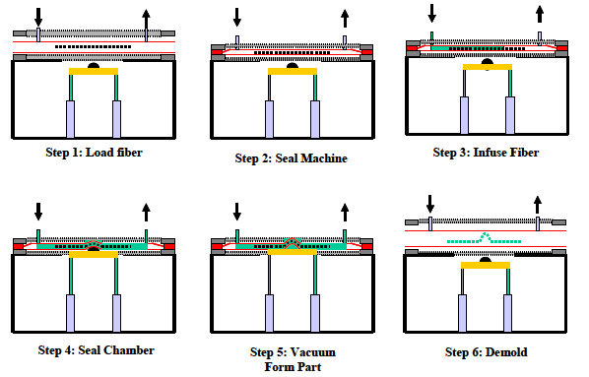
Introduction
RIDFT PROCESS

Slide 3
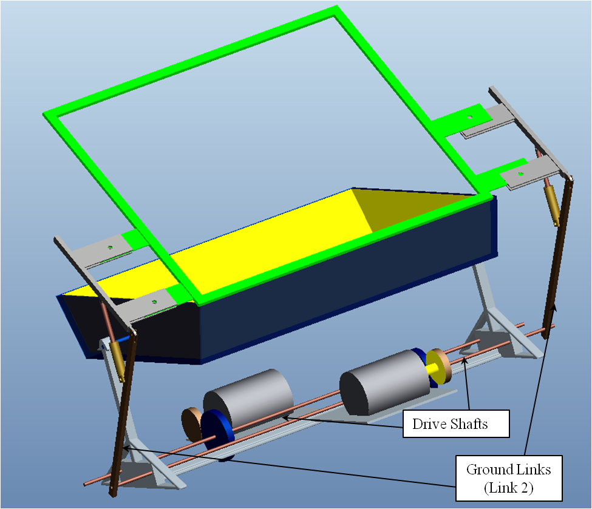
Past Design
Symmetric mirror image hydraulic linkage systems
.75 Hp DC motor driven
4 -10” stroke hydraulic cylinders
Gear and pinion pair (50T, 40T)

Slide 4
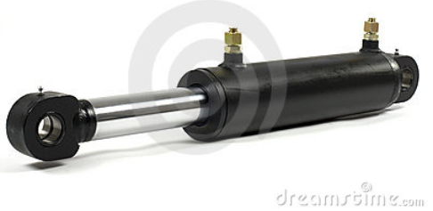
Design Issues
Total Cost -$14,000
  Bulk metal and custom gears
Safety
  Failure to meet OSHA standards
  Failure in hydraulics and materials not prevented
Floor Space
  Too much “real estate” taken up

Slide 5
RE DEFINITION
Voice of Customer
Safety
Less Man Power
Single Operator
Quality
Productivity
Easily Operable
Ergonomics
Man Power
Fewer Defects
Precise Parts
Shorter Cycle Time
Reduction of Setup Time
Controls
Design
Size
Color
Volume
Shape
Speed
Optimal RIDFT Automation
Safety
Less Man Power
Single Operator
Quality
Productivity
Easily Operable
Ergonomics
Foot Print
Fewer Defects
Precise Parts
Shorter Cycle Time
Reduction of Setup Time
Controls
Design
Size
Volume
Shape
Speed
Optimal RIDFT Automation
Color

Slide 6
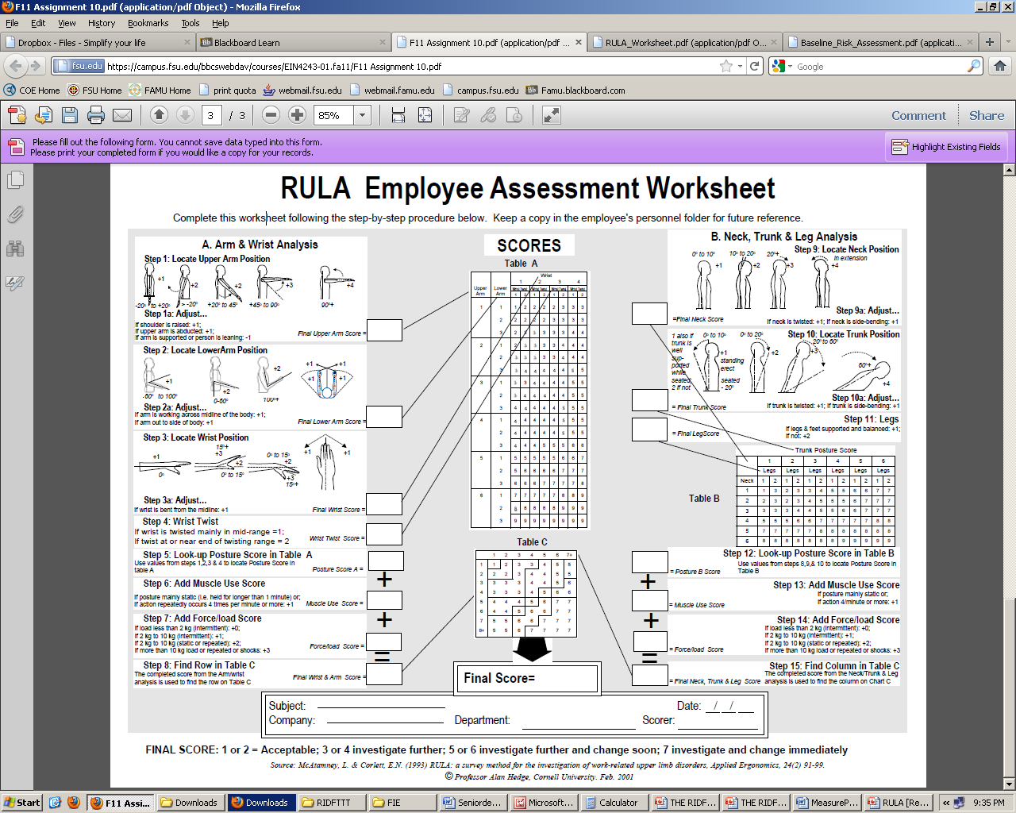
SAFETY
RULA- Ergonomic Tool used to
Measure Safety
of a process

Slide 7
RULA for present Ridft
Arm & Wrist
Neck, Trunk, & Legs
Upper arm
Lower arm
Wrist pos.
Wrist Twist
5
Final Score
3
Neck pos.
Trunk pos.
Legs
2
4
7
3
1
1
6
5
Posture score
Posture Score
0
9
8
0
Muscle use
Muscle use
Row score
Column score
3
3
Force/load
Force/load

Slide 8
Theoretical RULA for previous concept
Arm & Wrist
Neck, Trunk, & Legs
Upper arm
Lower arm
Wrist pos.
Wrist Twist
3
Final Score
1
Neck pos.
Trunk pos.
Legs
2
2
3
1
1
1
4
2
Posture score
Posture Score
0
4
2
0
Muscle use
Muscle use
Row score
Column score
0
0
Force/load
Force/load

Slide 9
expected RULA for present concept
Arm & Wrist
Neck, Trunk, & Legs
Upper arm
Lower arm
Wrist pos.
Wrist Twist
3
Final Score
1
Neck pos.
Trunk pos.
Legs
1
2
4
1
1
1
3
2
Posture score
Posture Score
0
6
2
0
Muscle use
Muscle use
Row score
Column score
3
0
Force/load
Force/load

Slide 10
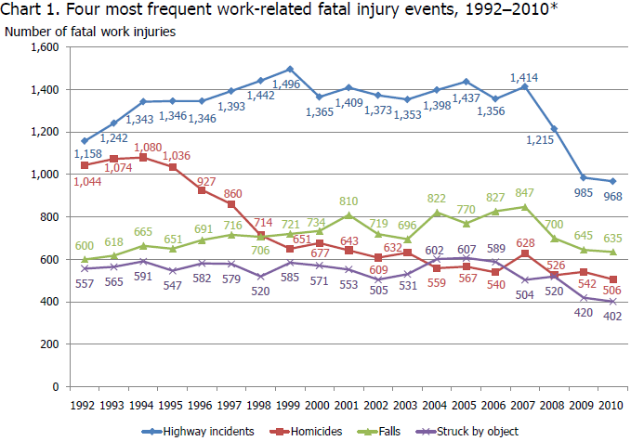
OSHA
Statistical data
Event | Total | % | Absent
Struck by Equipment | 119,130 | 12.19 | 5
Struck against Equipment | 67,170 | 7.2 | 5
Caught in Equipment | 41,040 | 4.4 | 9

Slide 11
ERGONOMIC ARM ANALYSIS Current Ridft
Height of Operator | Weight of Operator | Weight of Load | Weight of Supported Load | θ
68” | 150lb | 50lb | 25lb | 90°
∑Fy = 0R_{y +} F_{B} -.02W - F_{D} = 0
∑M_{A} = 0F_{B}(BC) -.02W(BD) - F_{D}(BE)
F_{Bicep =} 353.3 lb R_{y =} 325.3 lb

Slide 12
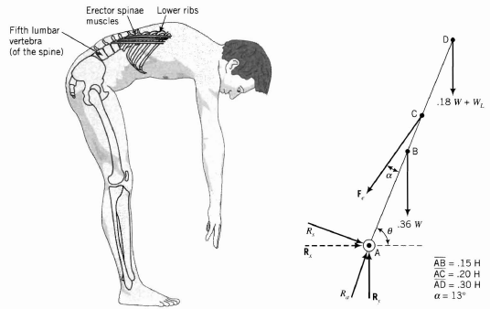
ERGONOMIC BENDING,LIFTING, AND CARRYING ANALYSIS
Height of Operator | Operator Weight | Load Weight | θ | α
68” | 150lb | 50lb | 57° | 13°
∑Fx = 0
R_{x} - F_{ex} = 0; R_{x} - F_{e}cos(θ-α) = 0
R_{x} = 626.4lb
∑Fy = 0
R_{y} - .36W – (.18W+W_{L}) – F_{ey} = 0
R_{y} - .36W – (.18W+W_{L}) - F_{e}sin (θ-α) = 0
R_{y} = -735.3 lb (Downward action)
∑M_{A} = 0
-.36W(AB)cos(θ) – (.18W+W_{L})(AD)cos(θ)- F_{ey}(AC)cos(θ)+
F_{ex}(AC)sin(θ)
F_{e} = (289.1/10.191) = 870.1lb ( Extensor Muscle Force)

Slide 13
Theoretical Ergonomic Analysis

Slide 14
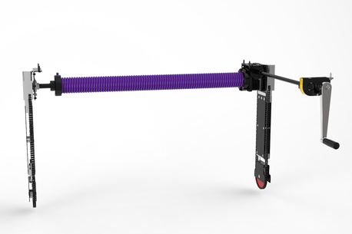
Concept Generation
Pros
  Ergonomically viable lift
  Portable table lift
Cons
  Lack of Safety Constraints
    Coil susceptible to brittle fracture
  Expensive
    Short coil life

Slide 15
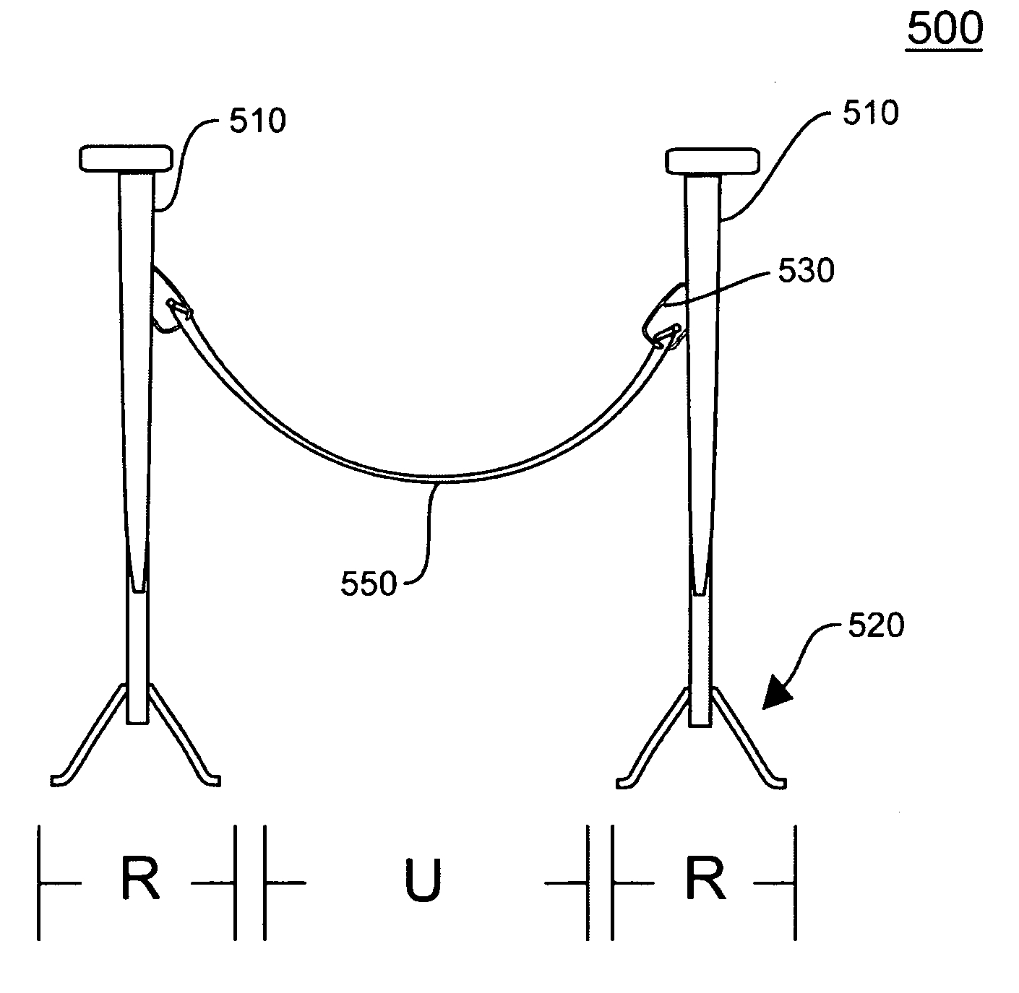
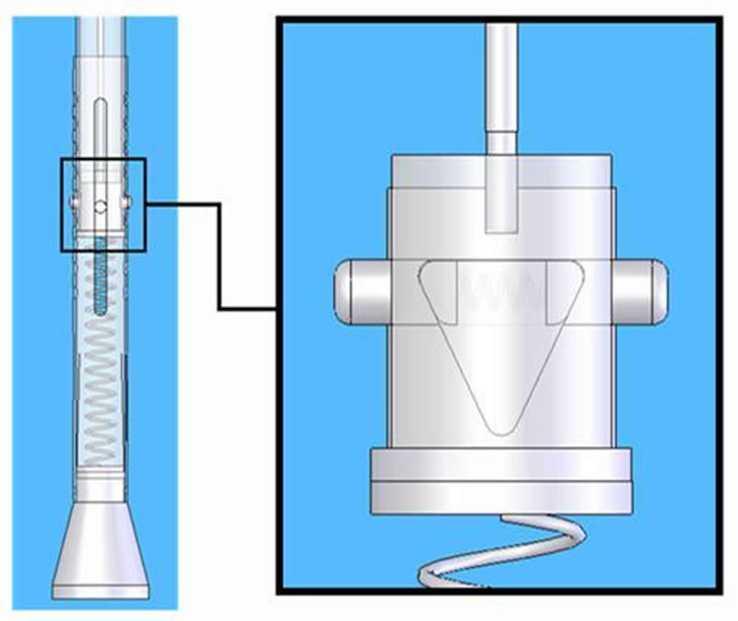
Concept Generation (Cont.)
Pros
  Portable (Swivel Wheels)
  Adjustable Safety Lock
  Sturdy
Cons
  No manner of precise placement
  Two Man Operation

Slide 16
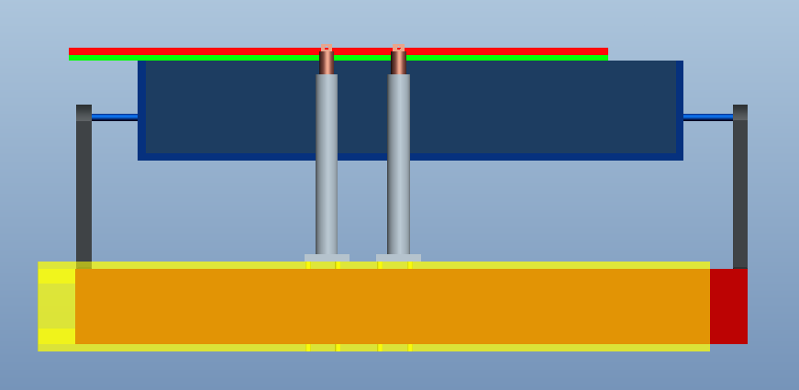
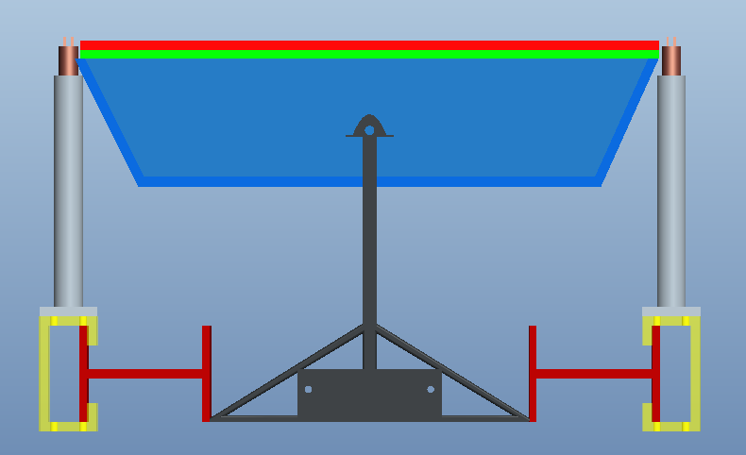
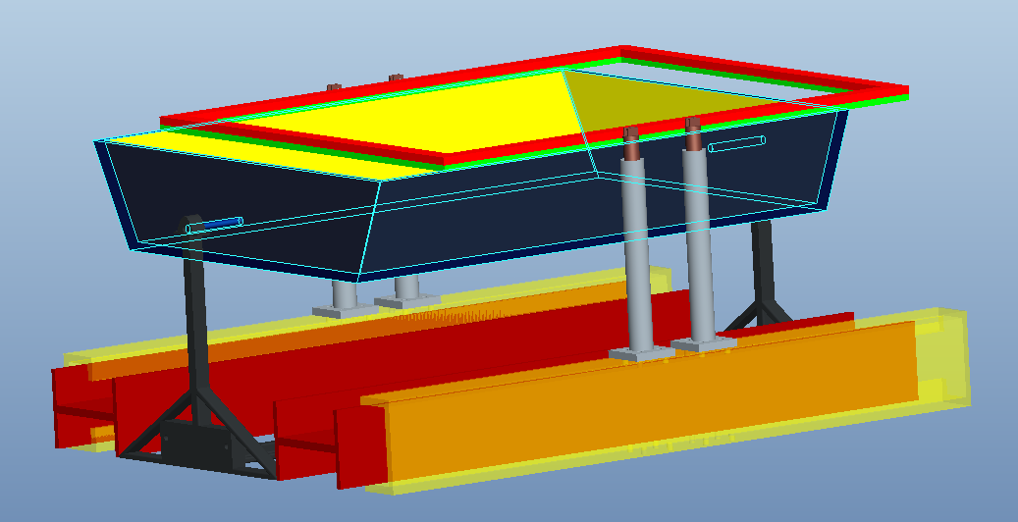
The Trolley

Slide 17
Conclusion
problem was redefined
new design must be assembled to meet project aims
Next phase : DESIGN

Slide 18

Questions

